Slide 1
Simulink Basics
SOEN385
Control Systems and Applications

Slide 2
Simullink
Graphical extension to MATLAB for the modeling and simulation of systems.
Systems are drawn on screen as block diagram:
  input devices (such as function generators)
  transfer functions, summing junctions, …
  output devices (such as oscilloscopes)

Slide 3
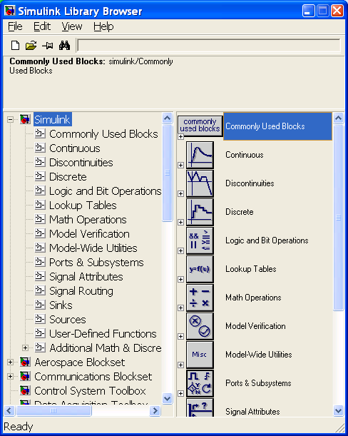
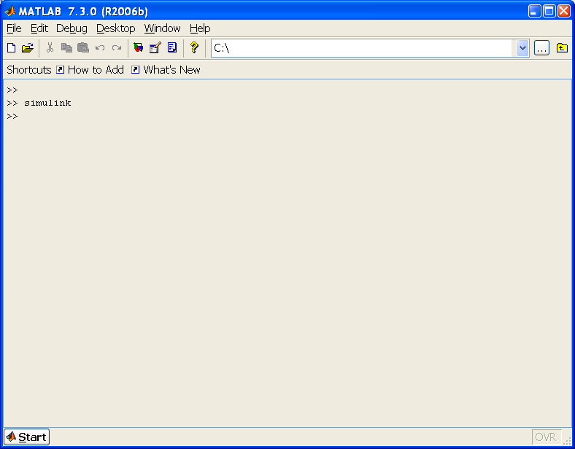
Starting Simulink
Clicking on Simulink icon or entering simulink

Slide 4
Basic Elements
There are two major classes of elements:
  Blocks
    Generate, modify, combine, input/output, and display signals.
  Lines
    Transfer signals from one block to another.

Slide 5

Simulink Blocks
Unused input terminals are indicated by a small open triangle.
Unused output terminals are indicated by a small triangular point.
Blocks have zero to several input terminals and zero to several output terminals.

Slide 6
Simulink Blocks
General classes of blocks available to use in Simulink folder:
  Sources: Used to generate various signals
    step, ramp, sinusoidal, ...
  Sinks: Used to output or display signals
    displays, scopes, graphs, ...
  Continuous: Linear, continuous-time system elements
    integrators, transfer functions, state-space models, ...
  Discrete: Linear, discrete-time system elements
    integrators, transfer functions, state-space models, ...
  Math Operations: Mathematical operators
    sum, gain, dot product, ...
  …

Slide 7
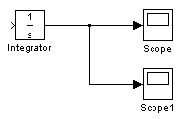
Lines
Transmit signals in the direction indicated by the arrow, from the output terminal of one block to the input terminal of another block.
  One exception is that a line can tap off of another line. This sends the original signal to each of two (or more) destination blocks:

Slide 8
Lines
A signal can be either a scalar signal or a vector signal.
For SISO systems, scalar signals are generally used.
For MIMO systems, vector signals are often used, consisting of two or more scalar signals.
The lines used to transmit scalar and vector signals are identical.
The type of signal carried by a line is determined by the blocks on either end of the line.

Slide 9
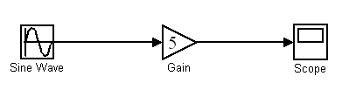
Building a Model
Block diagram for a simple model consisting of a sinusoidal input multiplied by a constant gain :

Slide 10
Building a Model
Steps to create a model:
  Click on the New Model button in the toolbar of the Simulink Library Browser.
  Gather the necessary blocks from the Library Browser and place them in the model window.
  Modify the parameters of the blocks modified to correspond with the system being modeled.
  Finally, connect the blocks with lines to complete the model.

Slide 11
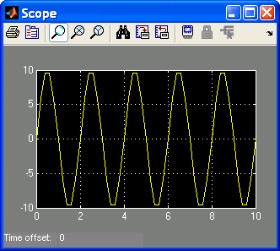
Simulating a Model
Once your system is built, run simulations to analyze its behavior.

Slide 12
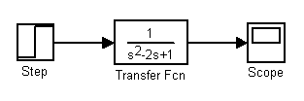
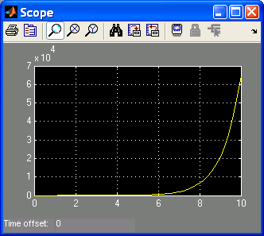
Transfer Functions
We can simply use the transfer function block of Simulink for analyzing the time response of systems.

Slide 13
References
Simulink
Simulation and Model-Based Design
http://www.mathworks.com/access/helpdesk/help/pdf_doc/simulink/sl_using.pdf
Simulink Tutorials, University of Michigan
http://www.engin.umich.edu/group/ctm/working/mac/

